Slide 1

Zepto E-commerce SQL Data Analyst Portfolio Project
A deep dive into real-world e-commerce data challenges, leveraging SQL for robust analysis and actionable insights.

Slide 2


PROJECT OVERVIEW
Setting the Stage: Real-World E-commerce Inventory Challenges
1
2
3
Messy Datasets
Flawed Insights
Our Goal
Zepto's inventory data mirrors the complexities of real-world datasets: riddled with missing values, inconsistent pricing, and duplicate entries.
Without meticulous data cleaning, these imperfections can lead to misleading analyses and poor business decisions.
To construct a reliable SQL-driven analysis pipeline, transforming raw, unstructured inventory data into a source of trustworthy insights.

Slide 3

Building the Messy Inventory Database
Database Structure
Our database includes key tables such as products, inventory, orders, and categories, each designed with realistic schema quirks to simulate an authentic e-commerce environment.
Common Issues Introduced
Null values in stock availability and pricing fields.
Prices stored in paise rather than rupees, with inconsistent formatting.
Duplicate Stock Keeping Units (SKUs) and invalid entries.

Slide 4
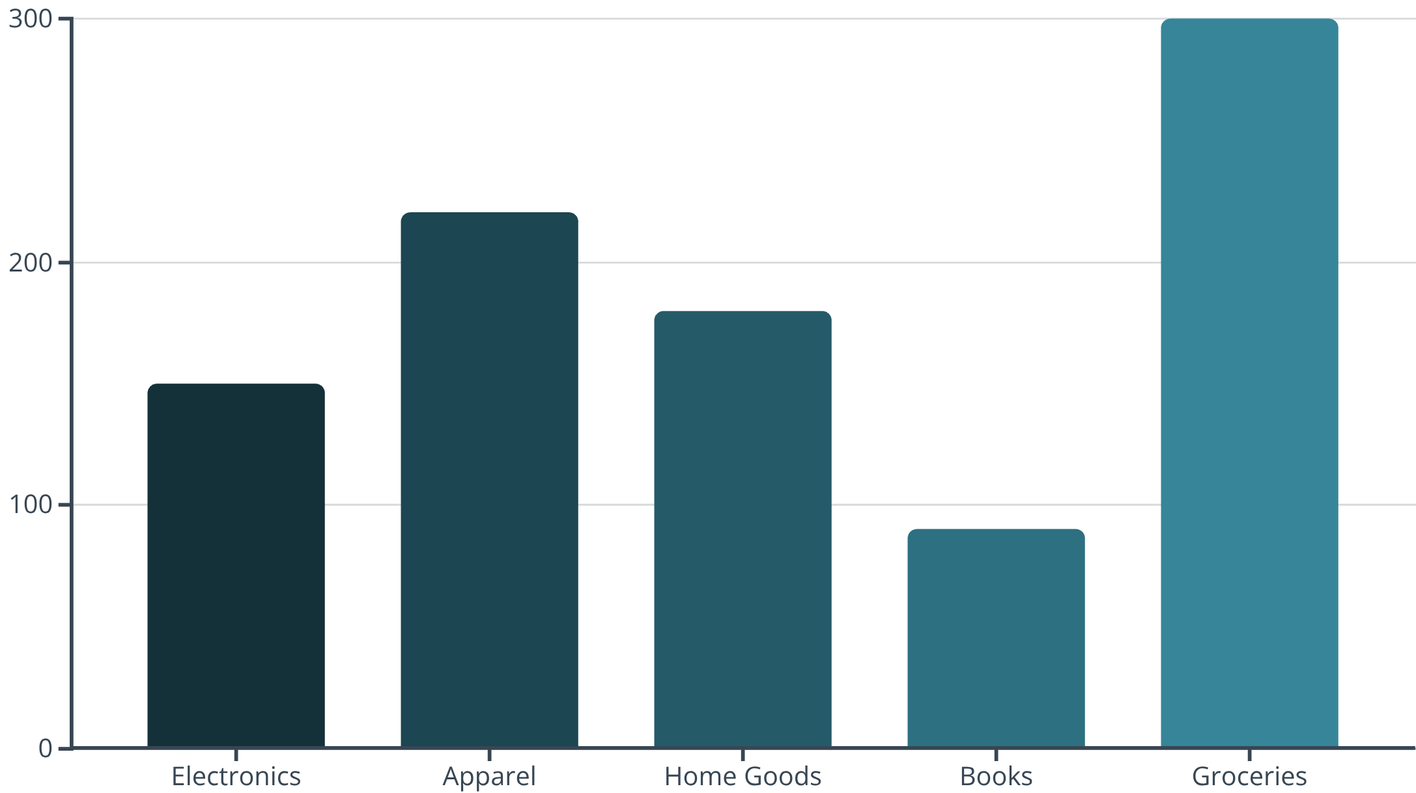
Exploratory Data Analysis (EDA): Uncovering Inventory Insights
Through thorough EDA, we gain initial insights into the dataset's structure and identify critical areas for data cleaning and further analysis.
Category Distribution: Analysing product categories to understand stock dominance.
Availability Gaps: Identifying the percentage of products that are out of stock or have low stock levels.
Pricing Anomalies: Detecting unusual pricing, including zero, negative, or suspicious outlier values.

Slide 5

Data Cleaning: Turning Messy Rows into Gold
1
2
Handling NULLs
Removing Duplicates
Utilising COALESCE and logical defaults, like assuming zero stock for null availability, to ensure data completeness.
Employing ROW_NUMBER() partitioned by SKU to eliminate redundant entries, streamlining the dataset.
3
4
Price Conversion
Filtering Invalid Entries
Converting prices from paise to rupees (dividing by 100) for accurate financial analysis and reporting.
Removing negative prices and impossible stock counts to maintain data integrity and reliability.

Slide 6
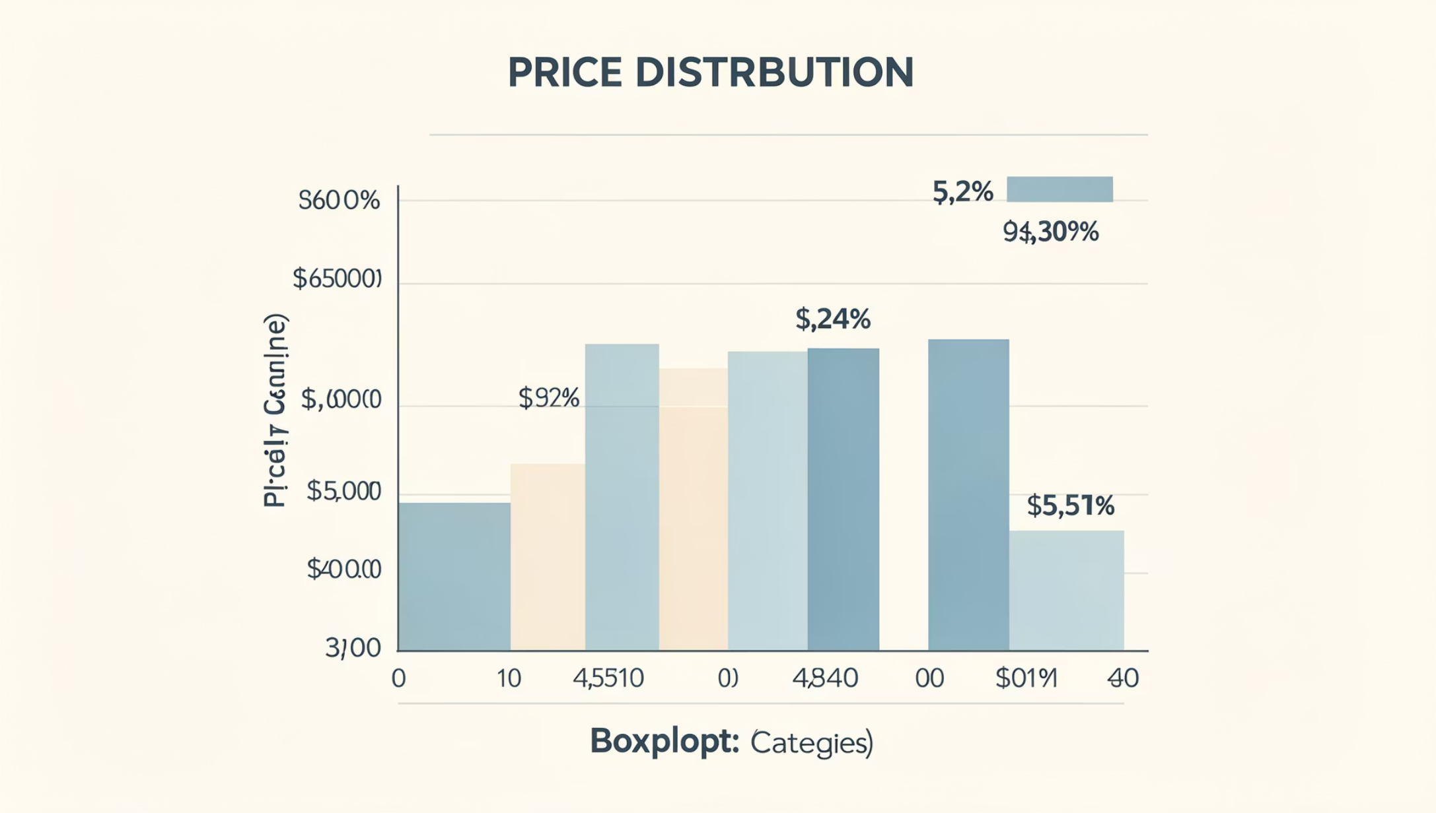
Business-Driven SQL Queries: Pricing Insights
Leveraging cleaned data, we execute targeted SQL queries to uncover critical pricing insights, ensuring competitive and accurate product valuations.
Average & Median Prices: Calculating these metrics per category post-cleaning.
Price Discrepancies: Identifying products with significant price differences between base and promotional rates.
Outlier Detection: Pinpointing pricing anomalies that may indicate data errors or unique selling propositions.

Slide 7
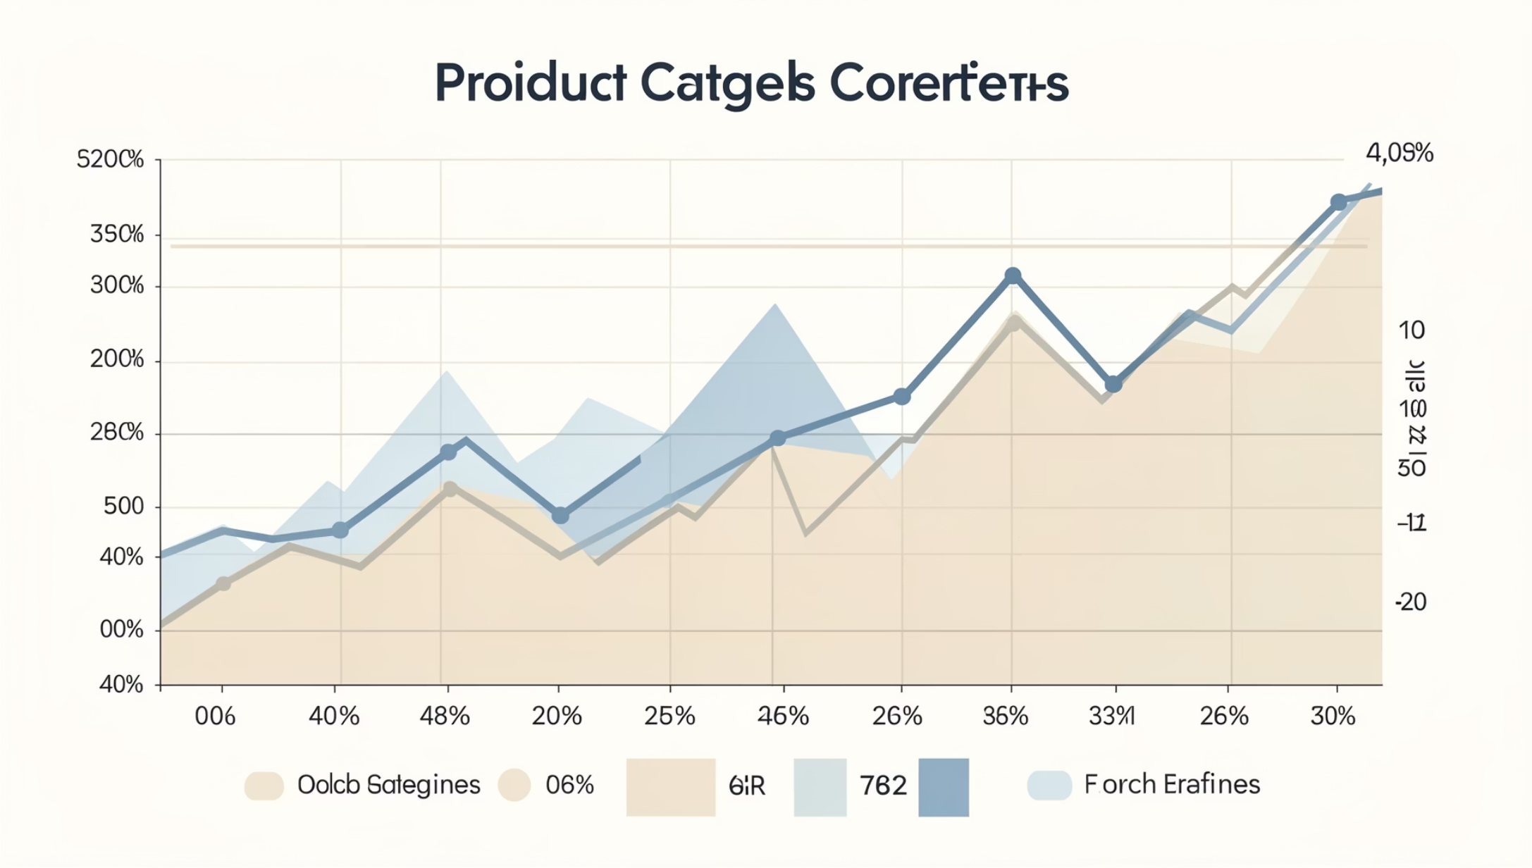
Business-Driven SQL Queries: Inventory & Stock Availability
Strategic SQL queries provide a clear picture of inventory levels and stock movements, essential for efficient supply chain management.
Total Stock: Assessing stock levels per category and warehouse location.
Availability Trends: Distinguishing between frequently out-of-stock and consistently available products.
Stock Turnover: Estimating turnover rates by analysing order and inventory data.

Slide 8
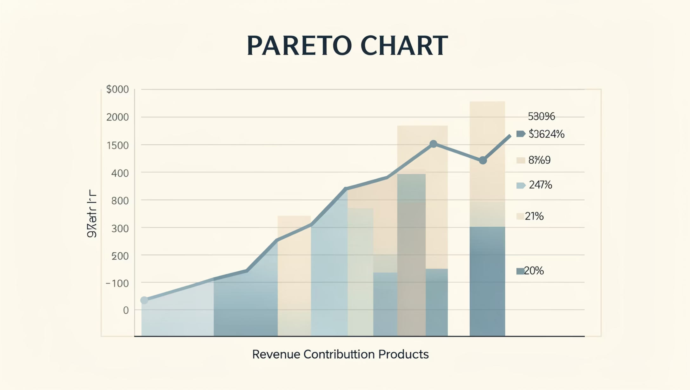
Business-Driven SQL Queries: Revenue & Sales Analysis
Advanced SQL queries facilitate a comprehensive analysis of revenue and sales performance, highlighting key drivers and potential losses.
Total Revenue: Calculating revenue per product and category using cleaned pricing and order data.
Top-Selling Products: Identifying best-performing products by revenue and quantity sold.
Lost Revenue: Estimating the impact of stockouts on potential revenue.

Slide 9

Key Takeaways & Portfolio Highlights
Real-World Data Proficiency
Demonstrated ability to effectively manage messy, real-world e-commerce datasets using SQL.
Rigorous Data Cleaning
Applied meticulous data cleaning techniques to ensure the integrity and trustworthiness of all insights.
Actionable Business Metrics
Delivered crucial business metrics on pricing, inventory, and revenue, providing valuable strategic guidance.
End-to-End SQL Skills
This project showcases comprehensive SQL skills, highly valuable for aspiring data analysts.

Slide 10


Ready to Elevate Your Data Analysis Portfolio?
Build Your Own Datasets
Construct messy e-commerce datasets to refine your SQL proficiency and problem-solving abilities.
Focus on Business Impact
Prioritise cleaning, EDA, and business-driven queries to maximise your project's impact and relevance.
Showcase Your Work
Highlight projects like Zepto's inventory analysis to distinguish yourself in the job market.
Connect & Explore
Let's connect and delve into how data can empower smarter business decisions and drive success.

